Slide 1

Logic
Presented by:
Elizer Ponio Jr.
Department of Computer Science
College of Computing and Information Technologies

Slide 2
Outline
Introduction and Definition
Statements
Conditional Statements
Quantifiers

Slide 3
Statements
The study of logic begins with statements.
A statement is a sentence or a mathematical expression that is either definitely true or definitely false

Slide 4
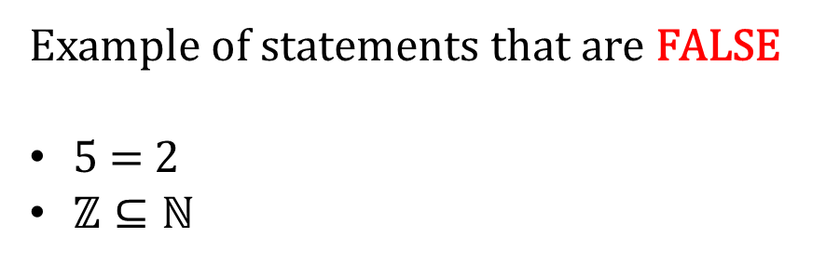
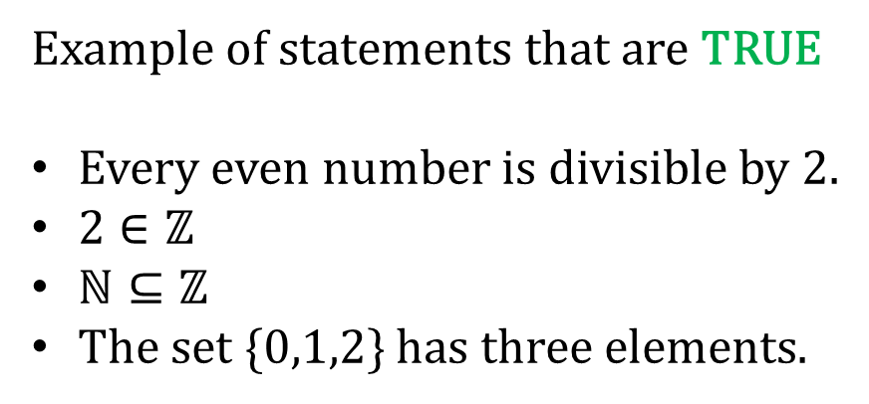
Statements
Example of statements that are TRUE
Every even number is divisible by 2.
$2∈ℤ$
$ℕ⊆ℤ$
The set {0,1,2} has three elements.
Example of statements that are FALSE
5 = 2
$ℤ⊆ℕ$

Slide 5


Statements
Example of statements that are TRUE
Every even number is divisible by 2.
$2∈ℤ$
$ℕ⊆ℤ$
The set {0,1,2} has three elements.
Example of statements that are FALSE
5 = 2
$ℤ⊆ℕ$

Slide 6
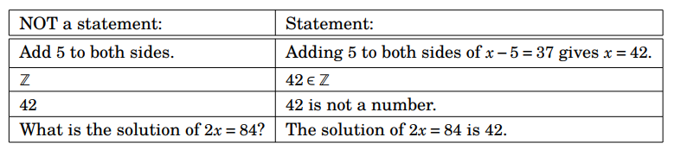
Statements

Slide 7



Conditional Statements
$$If P, then Q$$
$$P ⇒Q$$
$$P implies Q$$
Whenever P is true, Q must be true as well
Whenever P is false, we do not care!

Slide 8












Conditional Statements
Example:
$$Let x ∈ ℝ$$
$$P ⇒Q$$
$$x>10⇒x>6$$
$$x=12$$
$$T$$
$$T$$
$$x=8$$
$$F$$
$$T$$
$$x=3$$
$$F$$
$$F$$

Slide 9




Conditional Statements
Example:
$$Let n ∈ ℤ$$
$$n is even ⇐n is a multiple of 4$$
$$n is even⇔n+1 is odd$$
If and only if
$P⇔Q$
$P and Q both TRUE or both FALSE$
$P⇒Q and Q⇒P$
$P and Q are equivalent$

Slide 10
Conditional Statements
Example:
$$0>1⇒\text{103574289 }\text{is} \text{prime}$$
FALSE
???
TRUE

Slide 11
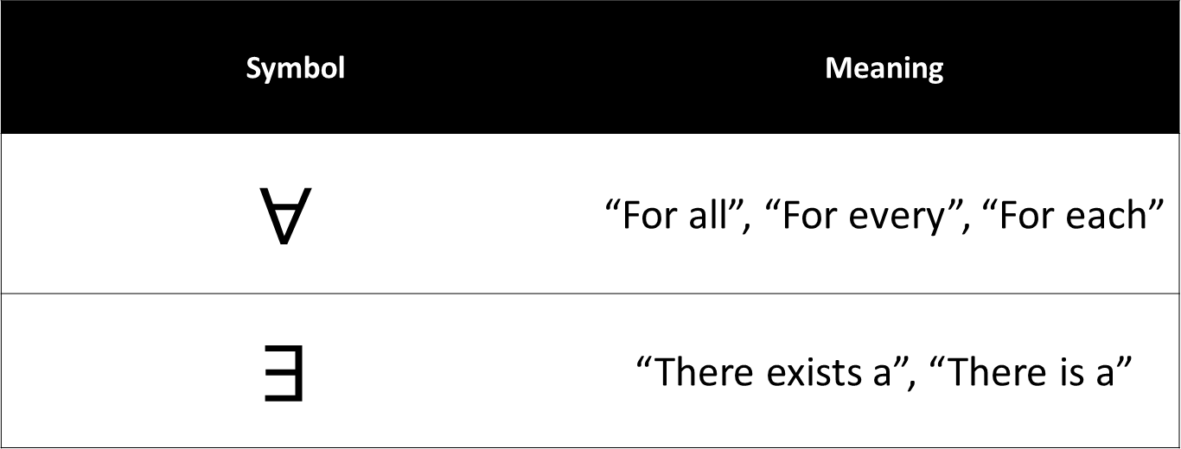
Quantifiers
Symbol | Meaning
$$∀$$ | “For all”, “For every”, “For each”
$$∃$$ | “There exists a”, “There is a”

Slide 12


Quantifiers
Example:
$$∀ x∈ ℝ, { x}^{2}≥0$$
TRUE
$$\text{For} \text{every} \text{real} \text{number} \text{x}\text{, }x^{2} is greater than or equal to zero$$
$$∀ x∈ ℤ, x>π$$
$$\text{For} \text{every} \text{integer} \text{x}\text{, }x^{2} is greater that pi$$
FALSE
This will be false if x = 1

Slide 13




Quantifiers
Example:
$$∃ x∈ ℝ{ such that x}^{2}=5$$
$$\text{There} \text{exists} \text{a} \text{real} \text{number} \text{such} \text{that} x^{2}=5$$
$$TRUE if x=−\sqrt{5}$$
$$∃ x∈ ℝ{ such that x}^{2}=−1$$
$$\text{There} \text{exists} \text{a} \text{real} \text{number} \text{such} \text{that} x^{2}=\text{-1 }$$
$$FALSE$$

